Slide 1
The Cocktail Party Problem: A Case Study in Deep Learning
DeLiang Wang
Perception & Neurodynamics Lab
Ohio State University
& Northwestern Polytechnical University

Slide 2
Outline of primer
What is the cocktail party problem?
Ideal binary mask and speech intelligibility
Speech separation as DNN based mask estimation
Speech intelligibility tests on hearing impaired listeners
Generalization to new noises
Ideal ratio mask
Reverberant speech separation
Speaker separation
Talker-dependent
Talker-independent

Slide 3
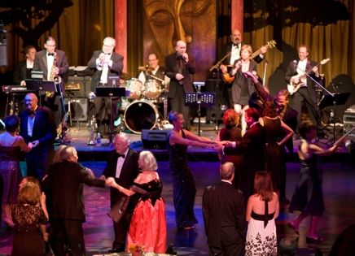
Real-world audition
What?
Speech
message
speaker
age, gender, linguistic origin, mood, …
Music
Car passing by
Where?
Left, right, up, down
How close?
Channel characteristics
Environment characteristics
Room reverberation
Ambient noise
Notes:
3

Slide 4

Sources of intrusion and distortion
additive noise from
other sound sources
channel distortion
reverberation from
surface reflections
Notes:
4

Slide 5
Cocktail party problem
Term coined by Cherry
“One of our most important faculties is our ability to listen to, and follow, one speaker in the presence of others. This is such a common experience that we may take it for granted; we may call it ‘the cocktail party problem.’ No machine has been constructed to do just that.” (Cherry, 1957)
Speech separation problem
Speech enhancement: speech-nonspeech separation
Speaker separation: multi-talker separation

Slide 6
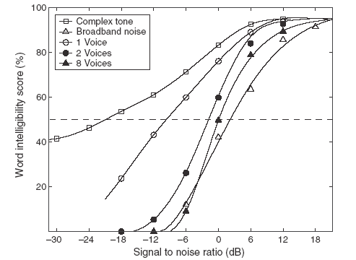
Human performance in different interferences
SRT 23 dB difference in Speech Reception
Threshold!
Source: Wang & Brown (2006)
Notes:
6
don’t comment at this point on the effect of competing speakers

Slide 7
Ideal binary mask as a separation goal
Motivated by the auditory masking phenomenon and auditory scene analysis, we suggested the ideal binary mask as a main goal of CASA (Hu & Wang, 2001; 2004)
The idea is to retain parts of a mixture where the target sound is stronger than the acoustic background, and discard the rest
The definition of the ideal binary mask (IBM)
θ: A local SNR criterion (LC) in dB, which is typically chosen to be 0 dB
Optimal SNR: Under certain conditions the IBM with θ = 0 dB is the optimal binary mask in terms of SNR gain (Li & Wang, 2009)
Maximal articulation index (AI) in a simplified version (Loizou & Kim, 2011)
It does not actually separate the mixture!

Slide 8
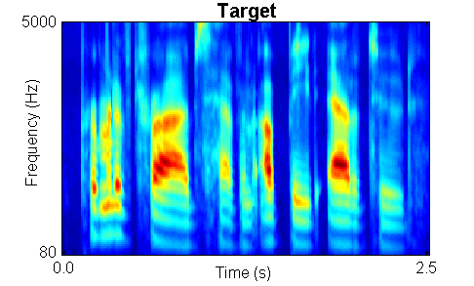
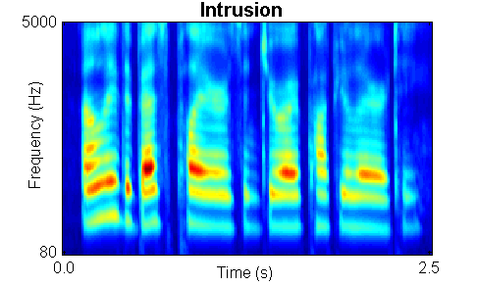

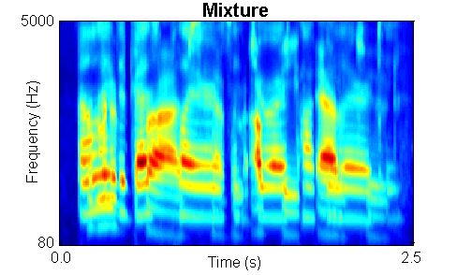
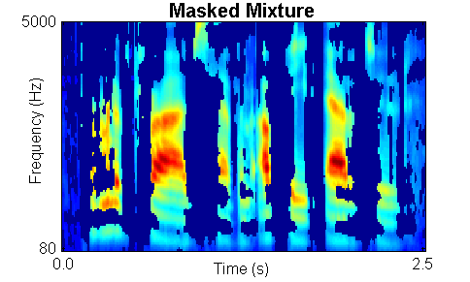
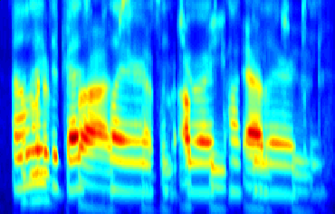
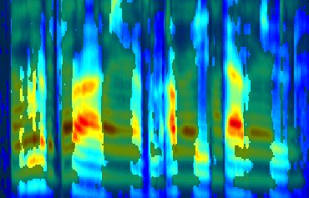
IBM illustration

Slide 9
Subject tests of ideal binary masking
IBM separation leads to dramatic speech intelligibility improvements
Improvement for stationary noise is above 7 dB for normal-hearing (NH) listeners (Brungart et al.’06; Li & Loizou’08; Ahmadi et al.’13; Chen’16), and above 9 dB for hearing-impaired (HI) listeners (Anzalone et al.’06; Wang et al.’09)
Improvement for modulated noise is significantly larger than for stationary noise
With the IBM as the goal, the speech separation problem becomes a binary classification problem
This new formulation opens the problem to a variety of pattern classification methods
Notes:
Brungart and Simpson (2001)’s experiments show coexistence of informational and energetic masking.
They have also isolated informational masking using across-ear effect when listening to two talkers in one ear experience informational masking from third signal in the opposite ear (Brungart and Simpson, 2002)
Arbogast et al. (2002) divide speech signal into 15 log spaced, envelope modulated sinewaves. Assign some to target and some to interference: intelligible speech with no spectral overlaps

Slide 10
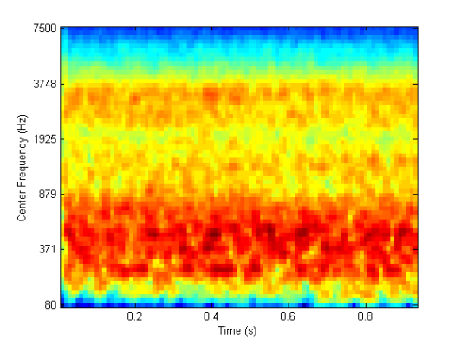

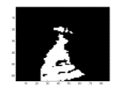
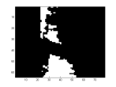
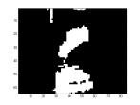
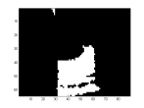
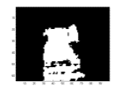
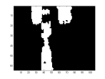
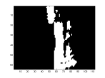
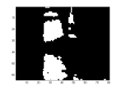
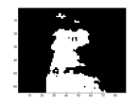
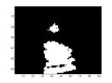
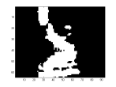
Speech perception of noise with binary gains
Wang et al. (2008) found that, when LC is chosen to be the same as the input SNR, nearly perfect intelligibility is obtained when input SNR is -∞ dB (i.e. the mixture contains noise only with no target speech)
IBM modulated noise for ???
Speech shaped noise (SSN)
Notes:
Create a continuous noise signal that match long-term average spectrum of speech
Further approach to divide “speech-spectrum-shaped” noise into number of bands and modulate with natural speech envelopes
However, noise signal too “speech-like” and reintroduce informational masking (Brungart et al. 2004)
Alternatively, use Ideal Binary Mask to remove informational masking
Eliminate portions of stimulus dominated by the interfering speech.
Retain only portions of target speech acoustically detectable in the presence of interfering speech

Slide 11
Outline of primer
What is the cocktail party problem?
Ideal binary mask and speech intelligibility
Speech separation as DNN based mask estimation
Speech intelligibility tests on hearing impaired listeners
Generalization to new noises
Ideal ratio mask
Reverberant speech separation
Speaker separation
Talker-dependent
Talker-independent

Slide 12
DNN as subband classifier (Wang & Wang’13)
Y. Wang and Wang (2013) first introduced DNN to address the speech separation problem
DNN is used for as a subband classifier, performing feature learning from raw acoustic features
Classification aims to estimate the IBM

Slide 13
DNN as subband classifier (Wang & Wang’13)

Slide 14
Extensive training with DNN
Training on 200 randomly chosen utterances from both male and female IEEE speakers, mixed with 100 environmental noises at 0 dB (~17 hours long)
Six million fully dense training samples in each channel, with 64 channels in total
Evaluated on 20 unseen speakers mixed with 20 unseen noises at 0 dB
DNN based classifier produced the state-of-the-art separation results at the time

Slide 15
Speech intelligibility evaluation
Healy et al. (2013) subsequently evaluated the classifier on speech intelligibility of hearing-impaired listeners
A very challenging problem: “The interfering effect of background noise is the single greatest problem reported by hearing aid wearers” (Dillon’12)
Two stage DNN training to incorporate T-F context in classification

Slide 16
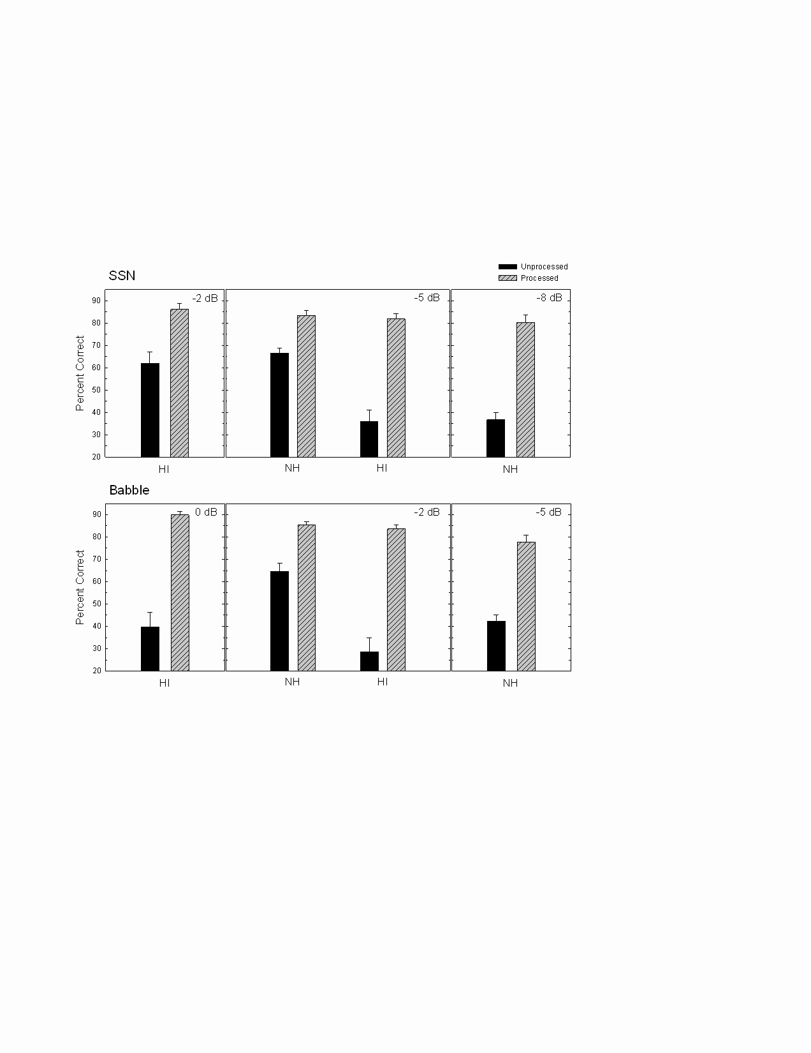

Results and sound demos
Both HI and NH listeners showed intelligibility improvements
HI subjects with separation outperformed NH subjects without separation

Slide 17
Generalization to new noises
While previous speech intelligibility results are impressive, a major limitation is that training and test noise samples were drawn from the same noise segments
Speech utterances were different
Noise samples were randomized
This limitation can be addressed through large-scale training for IRM estimation (Chen et al.’16)
IRM can be viewed as a soft version of the IBM

Slide 18
Large-scale training
Training set consisted of 560 IEEE sentences mixed with 10,000 (10K) non-speech noises (a total of 640,000 mixtures)
The total duration of the noises is about 125 h, and the total duration of training mixtures is about 380 h
Training SNR is fixed to -2 dB
The only feature used is the simple T-F unit energy
DNN architecture consists of 5 hidden layers, each with 2048 units
Test utterances and noises are both different from those used in training

Slide 19
STOI performance at -2 dB input SNR
 | Babble | Cafeteria | Factory | Babble2 | Average
Unprocessed | 0.612 | 0.596 | 0.611 | 0.611 | 0.608
100-noise model | 0.683 | 0.704 | 0.750 | 0.688 | 0.706
10K-noise model | 0.792 | 0.783 | 0.807 | 0.786 | 0.792
Noise-dependent model | 0.833 | 0.770 | 0.802 | 0.762 | 0.792
STOI is a standard metric for predicted speech intelligibility
DNN model with large-scale training provides similar results to noise-dependent model

Slide 20
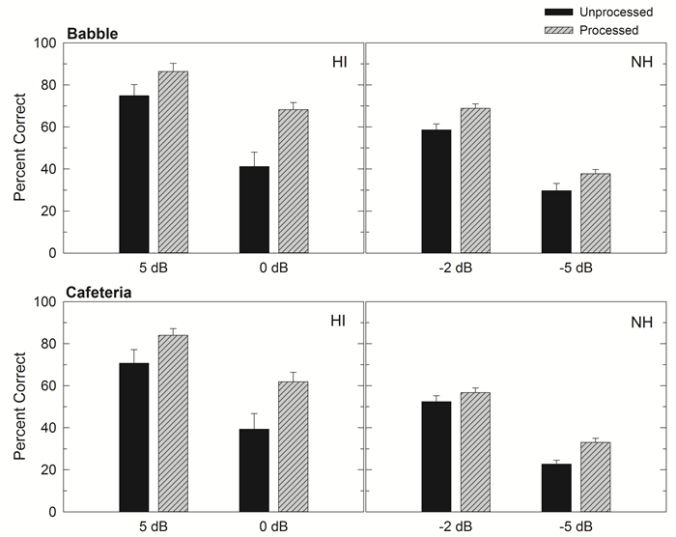
Listening test results
Both NH and HI listeners received benefit from algorithm processing in all conditions, with larger benefits for HI listeners

Slide 21
Outline of primer
What is the cocktail party problem?
Ideal binary mask and speech intelligibility
Speech separation as DNN based mask estimation
Speech intelligibility tests on hearing impaired listeners
Generalization to new noises
Ideal ratio mask
Reverberant speech separation
Speaker separation
Talker-dependent
Talker-independent

Slide 22
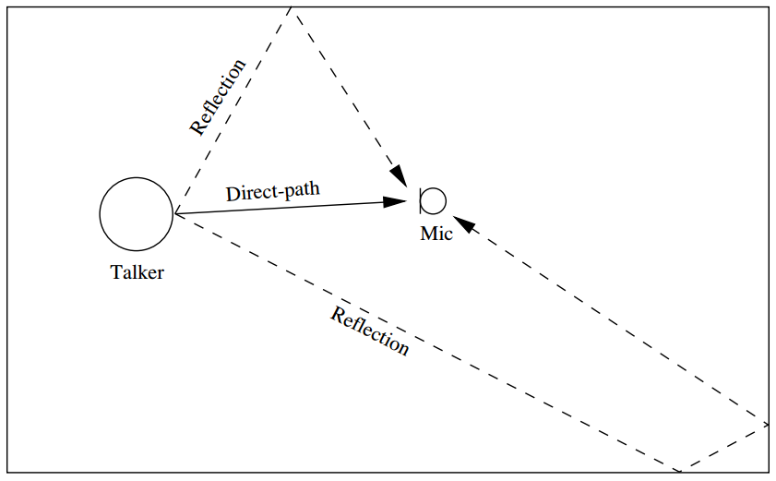
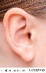
Reverberation
Reverberation is everywhere: Reflections of the sound source (direct sound) from various surfaces
Reverberation and background noise have confounding effects and can severely degrade speech intelligibility for HI listeners (Nabelek & Mason’81)

Slide 23
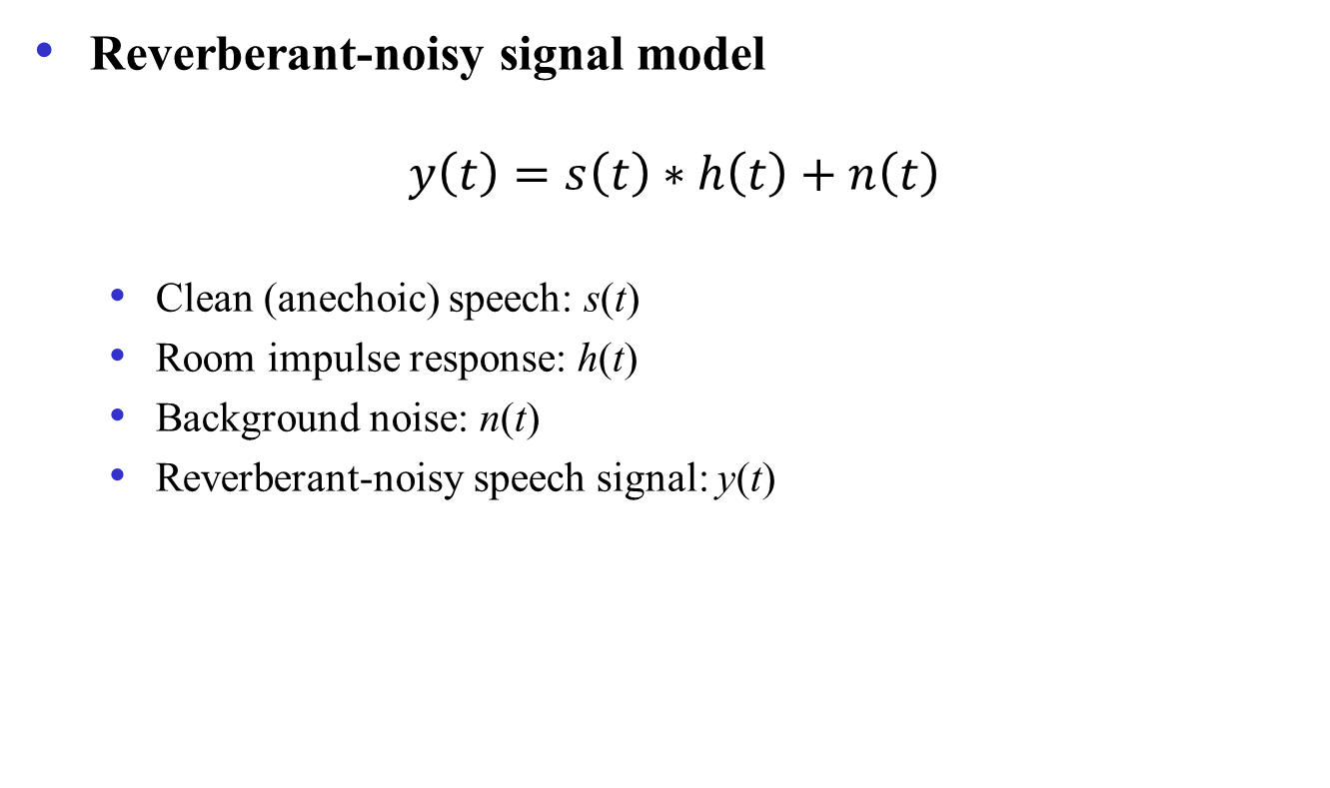
Signal model
Reverberant-noisy signal model
$$y\left(t\right)=s\left(t\right)∗h\left(t\right)+n\left(t\right)$$
Clean (anechoic) speech: s(t)
Room impulse response: h(t)
Background noise: n(t)
Reverberant-noisy speech signal: y(t)

Slide 24
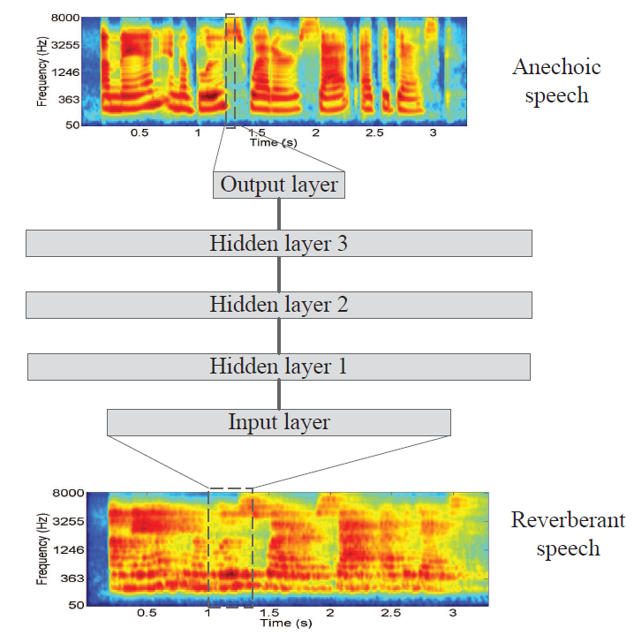
Previous spectral mapping work
Han et al. (2015) conducted the first DNN study on dereverberation and denoising
DNN was trained to learn the mapping from the spectrum of reverberant-noisy speech to the spectrum of anechoic speech (Lu et al.’13; Xu et al.’14; Han et al.’14)
However, an informal listening test indicates no speech intelligibility gain for HI listeners
Anechoic
speech
Reverberant-noisy
speech

Slide 25
Enhancement of reverberant-noisy speech as mask estimation
Zhao et al. (2018) recently approached dereverberation and denoising as IRM estimation
The input is a set of complementary features
DNN architecture
Feedforward network with four hidden layers, each with 2048 units
Speech intelligibility evaluation of enhanced speech on HI and NH listeners
Reverberation time (T60) is 0.6 s

Slide 26
Sound demos - typical stimuli
SSN (-5 dB)
Babble (0 dB)
Example 1
unprocessed
processed
clean
Example 3
unprocessed
processed
clean
Example 2
unprocessed
processed
clean
Example 4
unprocessed
processed
clean

Slide 27
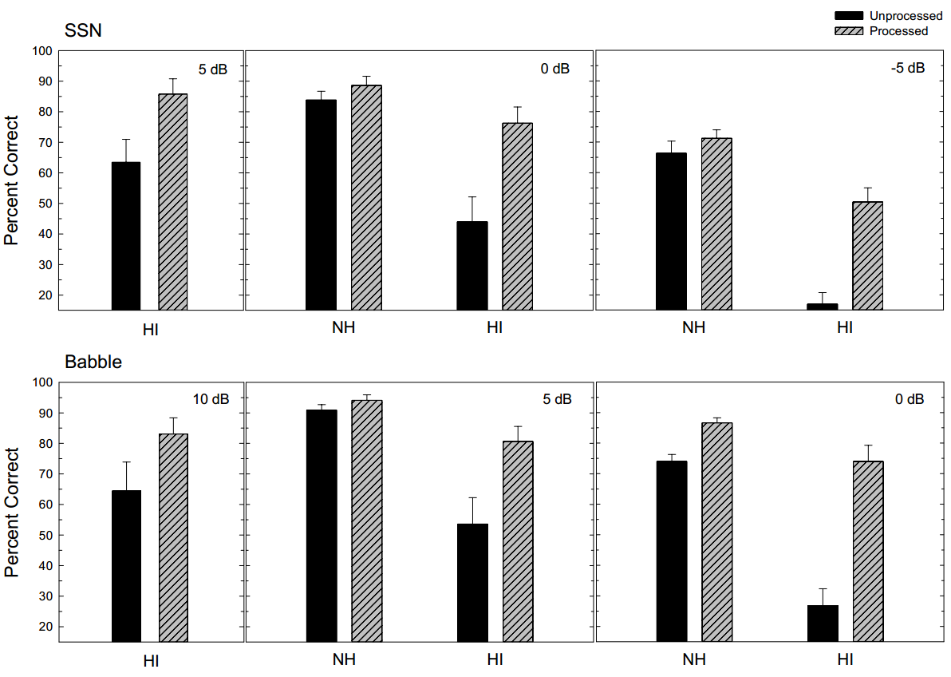
Intelligibility results

Slide 28
Outline of primer
What is the cocktail party problem?
Ideal binary mask and speech intelligibility
Speech separation as DNN based mask estimation
Speech intelligibility tests on hearing impaired listeners
Generalization to new noises
Ideal ratio mask
Reverberant speech separation
Speaker separation
Talker-dependent
Talker-independent

Slide 29
Speaker separation
Earlier work shows that DNN based IBM/IRM estimation remains an effective approach to address speaker separation (Huang et al.’14; Du et al.’14)
We recently addressed reverberant two-talker separation as DNN-based IRM estimation (Healy et al.’19)

Slide 30
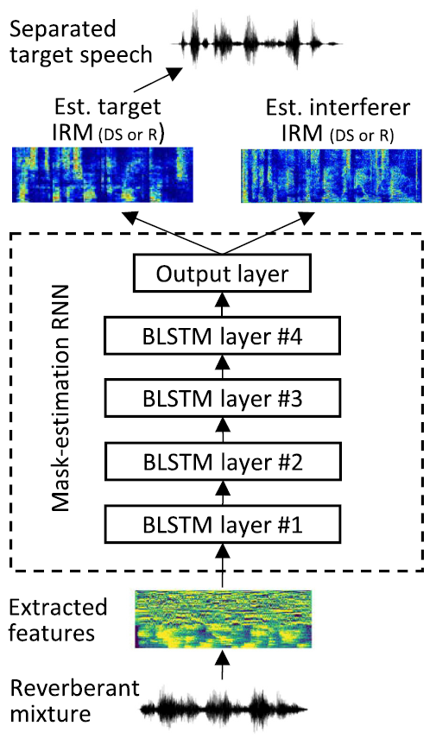
Ratio masking for reverberant speaker separation
We train a recurrent neural network (RNN) with bidirectional long short-term memory (BLSTM)
To separate either direct-sound (DS) target speaker, or reverberant (R) target speaker
Target speaker at 1 m distance and interferer at 2 m, with T60 = 0.6 s

Slide 31
STOI and PESQ performance
For DS (anechoic) target speaker separation
Input SNR (dB) | Unprocessed STOI | Processed STOI | Unprocessed PESQ | Processed PESQ
-6.00 | 45.6 | 78.7 | 1.54 | 2.30
-3.00 | 50.8 | 81.4 | 1.60 | 2.41
0.00 | 56.1 | 83.6 | 1.66 | 2.50
3.00 | 61.0 | 85.1 | 1.76 | 2.58
6.00 | 65.1 | 86.3 | 1.88 | 2.67
Large STOI and PESQ (standard speech quality metric) improvements are obtained by the speaker separation model

Slide 32
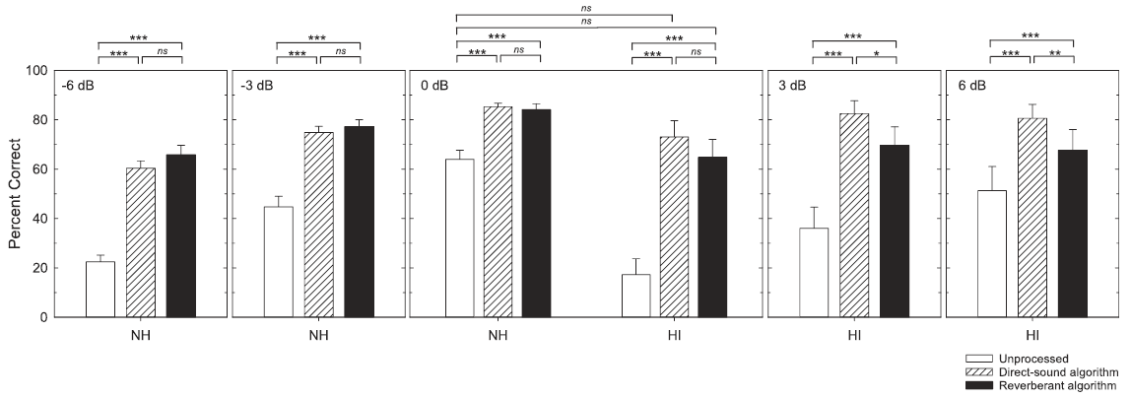
Listening test results and demos
First demonstration of intelligibility improvements for HI listeners in both interfering speech and room reverberation
At the common SNR of 0 dB, HI listeners with algorithm benefit outperform NH listeners without processing

Slide 33
Talker-independent speaker separation
This is the most general case, and it cannot be adequately addressed by training with many speaker pairs
Talker-independent separation can be treated as unsupervised clustering (Bach & Jordan’06; Hu & Wang’13)
Such clustering, however, does not benefit from discriminant information utilized in supervised training
Deep clustering (Hershey et al.’16) is the first approach to talker-independent separation by combining DNN based supervised feature learning and clustering

Slide 34
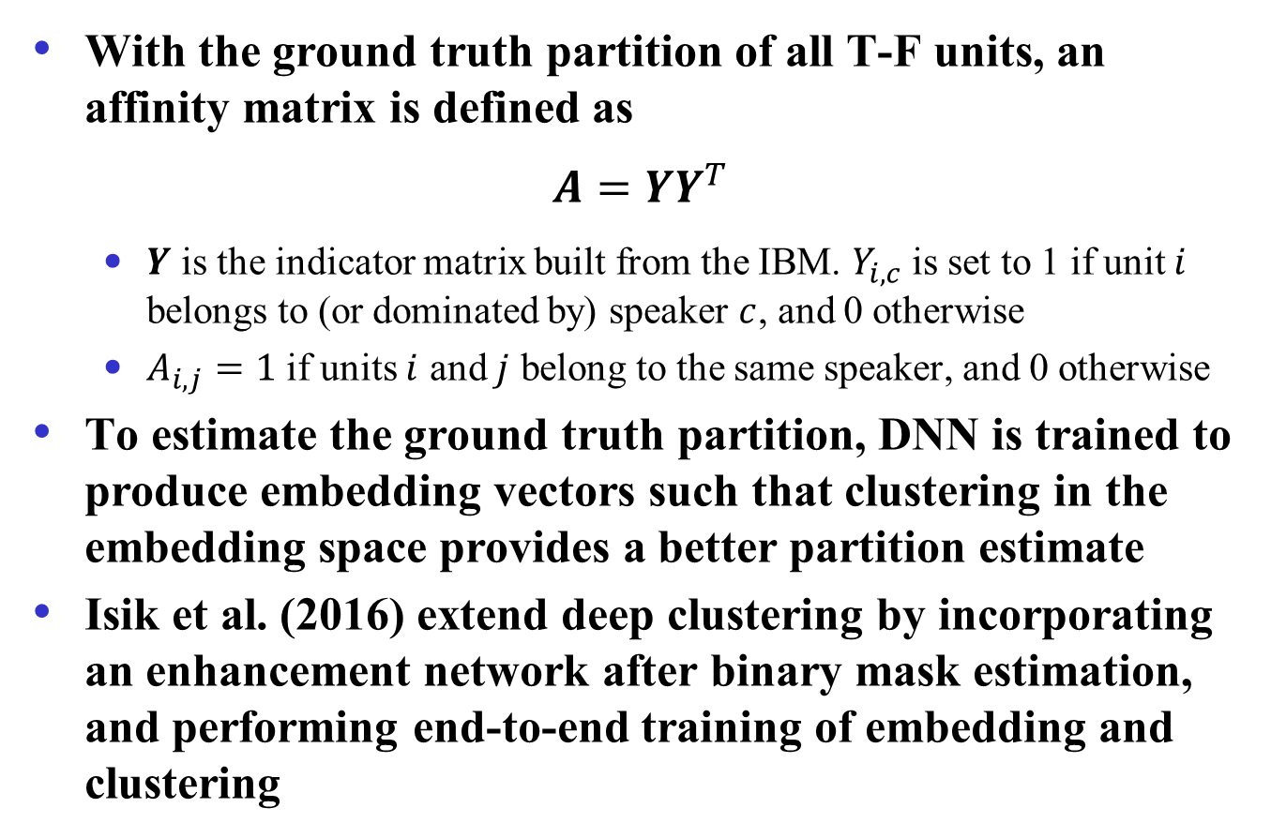
Deep clustering
With the ground truth partition of all T-F units, an affinity matrix is defined as
$$A=YY^{T}$$
$Y$ is the indicator matrix built from the IBM. $Y_{i, c}$ is set to 1 if unit $i$ belongs to (or dominated by) speaker $c$, and 0 otherwise
$A_{i, j}=1$ if units $i$ and $j$ belong to the same speaker, and 0 otherwise
To estimate the ground truth partition, DNN is trained to produce embedding vectors such that clustering in the embedding space provides a better partition estimate
Isik et al. (2016) extend deep clustering by incorporating an enhancement network after binary mask estimation, and performing end-to-end training of embedding and clustering

Slide 35
Permutation invariant training (PIT)
Recognizing that talker-dependent separation ties each DNN output to a specific speaker (permutation variant), PIT seeks to untie DNN outputs from speakers in order to achieve talker independence (Kolbak et al.’17)
Specifically, for a pair of speakers, there are two possible assignments, each of which is associated with a mean squared error (MSE). The assignment with the lower MSE is chosen and the DNN is trained to minimize the corresponding MSE
Two versions of PIT
Frame-level PIT (tPIT): Permutation can vary from frame to frame, hence needs speaker tracing (sequential grouping) for speaker separation
Utterance-level PIT (uPIT): Permutation is fixed for a whole utterance, hence needs no speaker tracing

Slide 36
CASA based approach
Limitations of deep clustering and PIT
In deep clustering, embedding vectors for T-F units with similar energies from underlying speakers tend to be ambiguous
uPIT does not work as well as tPIT at the frame level, particularly for same-gender speakers, but tPIT requires speaker tracing
Speaker separation in CASA is talker-independent
CASA performs simultaneous (spectral) grouping first, and then sequential grouping across time
Liu & Wang (2018) proposed a CASA based approach by leveraging PIT and deep clustering
For simultaneous grouping, tPIT is trained to predict the spectra of underlying speakers at each frame
For sequential grouping, DNN is trained to predict embedding vectors for simultaneously grouped spectra

Slide 37
Sequential grouping in CASA
Differences from deep clustering
In deep clustering, DNN based embedding is done at the T-F unit level, whereas it is done at the frame level in CASA
Constrained K-means in CASA ensures that the simultaneously separated spectra of the same frame are assigned to different speakers

Slide 38
Speaker separation performance
Talker-independent separation produces high-quality speaker separation results, rivaling talker-dependent separation results
No reverberation is considered
SDR improvements (in dB)

Slide 39

Talker-independent speaker separation demos
New pair of male-male speaker mixture
Speaker1 -uPIT
Speaker2 - uPIT
Speaker1 – DC++
Speaker2 – DC++
Speaker1 - CASA
Speaker2 - CASA
Speaker1 - clean
Speaker2 - clean

Slide 40
Rapid advances in talker-independent speaker separation
∆SI-SDR (dB), ∆SDR (dB) and PESQ comparison between recent algorithms on the open speaker condition of wsj0-2mix and wsj0-3mix. (“-” means not reported)
Approaches | wsj0-2mix |  |  | wsj0-3mix
 | ∆SI-SDR | ∆SDR | PESQ | ∆SI-SDR | ∆SDR | PESQ
Unprocessed | 0.0 | 0.0 | 2.01 | 0.0 | 0.0 | 1.66
DC++ (Isik et al., 2016) | 10.8 | - | - | 7.1 | - | -
uPIT-ST (Kolbaek et al., 2017) | - | 10.0 | - | - | 7.7 | -
ADANet (Luo et al. 2018a) | 10.4 | 10.8 | 2.82 | 9.1 | 9.4 | 2.16
Chimera++ (BLSTM) (Wang et al., 2018a) | 11.2 | 11.5 | - | - | - | -
+WA-MISI-5 (Wang et al., 2018b) | 12.6 | 12.9 | - | - | - | -
+ Filterbank learning (Wichern et al., 2018) | 12.8 | - | - | - | - | -
+ PhaseBook (Le Roux et al., 2018) | 12.6 | - | - | - | - | -
BLSTM-TasNet (Luo et al., 2018b) | 13.2 | 13.6 | 3.04 | - | - | -
conv-TasNet-gLN (Luo et al., 2018c) | 14.6 | 15.0 | 3.25 | 11.6 | 12.0 | 2.50
Sign Prediction Net (Wang et al., 2018c) | 15.3 | 15.6 | 3.36 | 12.1 | 12.5 | 2.64

Slide 41
A solution in sight for cocktail party problem?
What does a solution to the cocktail party problem look like?
A system that achieves human auditory analysis performance in all listening situations (Wang & Brown’06)
An automatic speech recognition (ASR) system that matches the human speech recognition performance in all noisy environments
Dependency on ASR

Slide 42

A solution in sight (cont.)?
A speech separation system that helps hearing-impaired listeners to achieve the same level of speech intelligibility as normal-hearing listeners in all noisy environments
This is my current working definition – see my IEEE Spectrum cover story in March, 2017

Slide 43
Conclusion
Formulation of the cocktail party problem as mask estimation enables the use of supervised learning
Supervised separation has yielded the first demonstrations of speech intelligibility improvement in noise
Large-scale training with DNN is a promising direction to make speech separation perform in a variety of conditions
Reverberant-noisy speech separation can be effectively addressed in the same framework
Major advances in both talker-dependent and talker-independent speaker separation
The cocktail party problem is within reach

